Slide 1

SELLING DIGITAL DEVICES WEBSITE (ZENTRIX)
TEAM 3 – CT25_CPL_JAVA_01

Slide 2
Team members
Lê Nhựt Anh
Huỳnh Hoàng Tỹ
Đặng Công Khanh
Nguyễn Lê Khắc Vũ
Nguyễn Thanh Bình
Nguyễn Việt Nguyên
Võ Lâm Thúy Vi

Slide 3
INTRODUCTION
TEAM 3 – CT25_CPL_JAVA_01

Slide 4
Introduction
Zentrix is an e-commerce web application specializing in selling electronic devices such as laptops, smartphones, tablets, accessories, and more.
The platform is designed to provide a fast, secure, and user-friendly shopping experience for customers while enabling administrators to efficiently manage products, orders, and customer interactions.
With Zentrix, customers can easily browse, compare, and purchase electronic products from a well-organized and responsive website.
Meanwhile, the admin panel offers powerful tools to manage inventory, track orders, and analyze sales data, making it an ideal solution for businesses in the electronics retail industry.

Slide 5



Introduction
Technologies used:
Frontend: ReactJS
Backend: Spring Boot
Database: PostgreSQL

Slide 6
Introduction
Basic hardware requirements:
CPU:
Minimum: Intel Core i3 (3th Gen) or AMD Ryzen 3.
Recommended: Intel Core i5 (6th Gen or newer) or AMD Ryzen 5.
RAM:
Minimum: 4GB.
Recommended: 8GB (to run smoothly).
Application platform
Browser: Chrome.

Slide 7
DATABASE DIAGRAM
TEAM 3 – CT25_CPL_JAVA_01

Slide 8
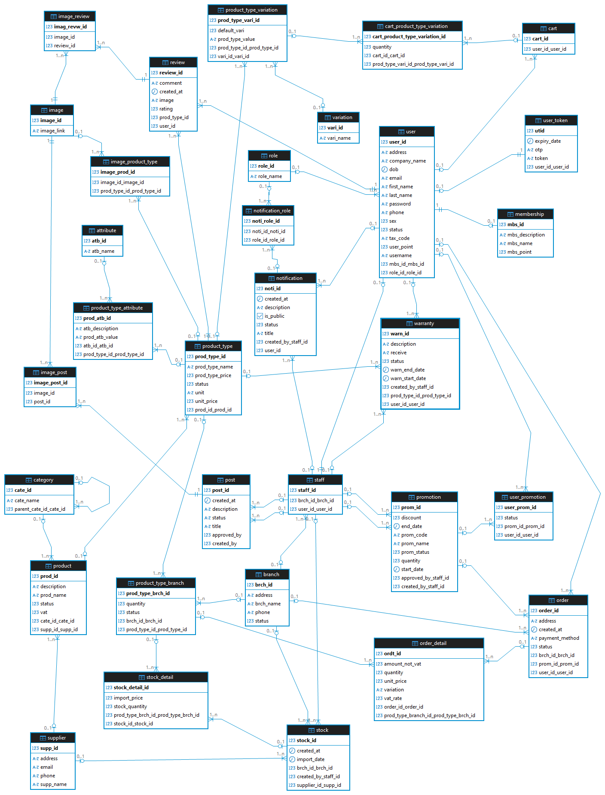
Database

Slide 9
Database

Slide 10
Database

Slide 11
SCENARIO
TEAM 3 – CT25_CPL_JAVA_01

Slide 12
Scenario
Login
(Admin)
View
dashboard
Create
branch
Create
supplier
Create
category
Create
product
Review product
Place order
Compare price
Register
Create promotion
Import stock

Slide 13
DEMO
TEAM 3 – CT25_CPL_JAVA_01

Slide 14

THANKS FOR FOLLOWING

